Slide 1
Twitter Sentiment Analysis on India’s demonetization event
By
Divij Jobanputra (2819861)

Slide 2
Outline
Introduction
Sentiment analysis
Dataset
Cleaning the data
Apply Sentiment Analysis
Result of how people reacted overall
Visualize the result
Store result to RDBMS
Challenges / Limitations

Slide 3
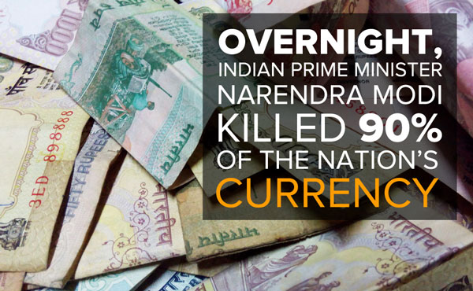
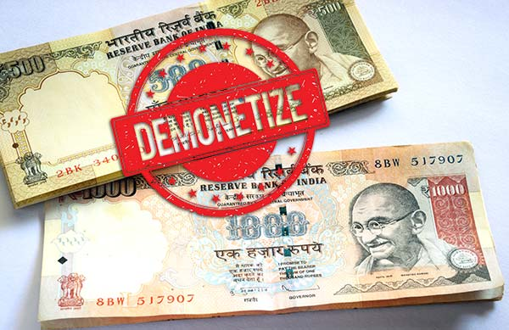
Demonetization in india (2016)
On November 8, 2016, Prime minister of India announced in an unscheduled national, that two high-value notes of Indian currency of 500 and 1000 is invalid with the immediate effect.
Result = 86% of existing currency became invalid
Aim = destroy counterfeit currency, reduce corruption, stop terrorism financing, etc.
Resulted in extremely long queues, chaos and panic across the nation.
People reacted about the event on the social media including twitter with their own opinion and views.

Slide 4
Steps of application
Data Collection
(Collected Tweets from CSV)
Data Preprocessing
(lowercase, stopwords, punctuations, hashtags, etc.)
Sentiment Analysis
(Calculate polarity of cleaned text)
Sentiment Results
(Visualizing the result using graphs)
Store data and results to RDBMS

Slide 5
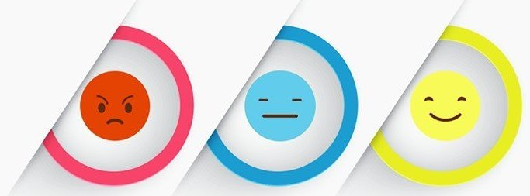
What is sentiment Analysis?

Slide 6
Sentiment analysis
text analysis method that detects polarity.
Text document, paragraph or sentence
Result : positive, negative or neutral
2 types:
Lexicon based
Machine learning based

Slide 7
Data INFO
Taken from:
Size:
Type:
www.kaggle.com
Around 15000 tweets about the event.
CSV document

Slide 8
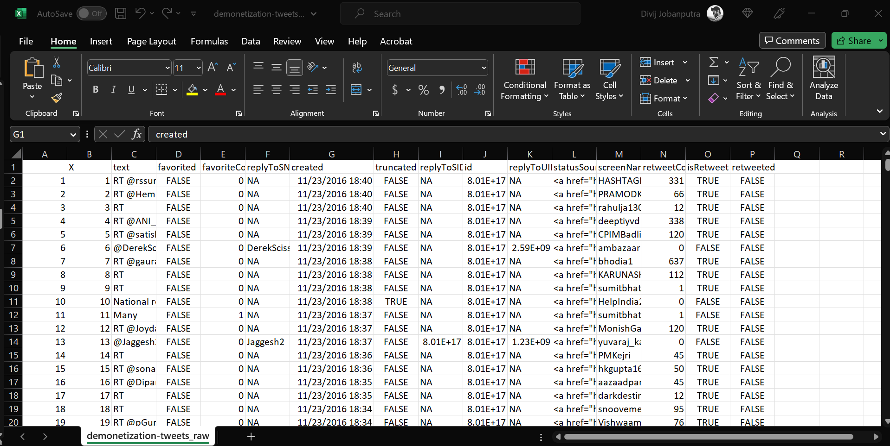
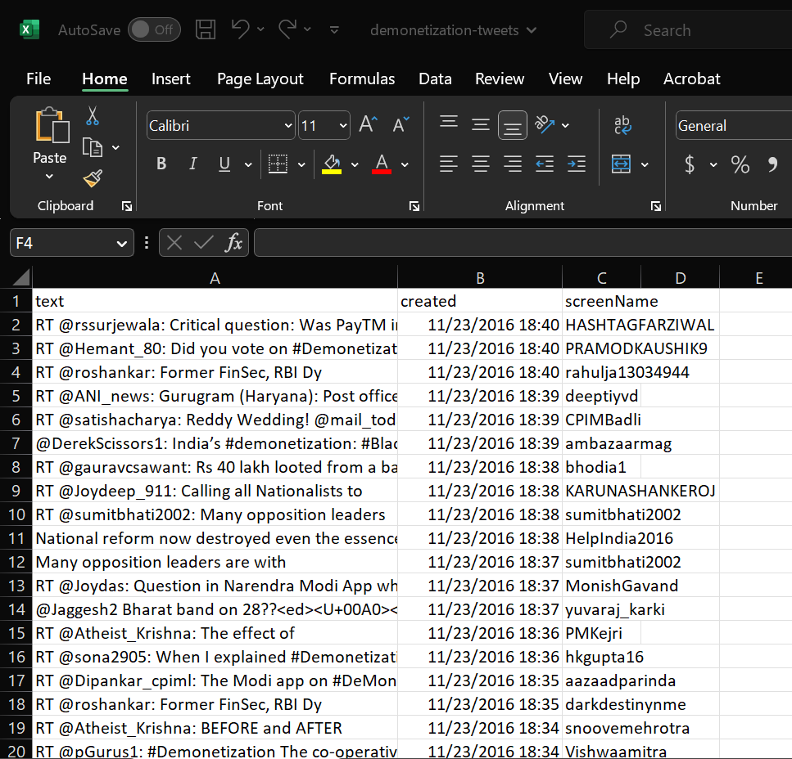
demonetization_tweets_raw.csv
demonetization_tweets.csv

Slide 9
Platform setting/system configuration for project:
Anaconda distribution for data analysis
VS Code for Python Script
SQL Server, SSMS client for RDBMS
Some libraries I used:
Re
Pandas
Textblob
Matplotlib
pyodbc

Slide 10
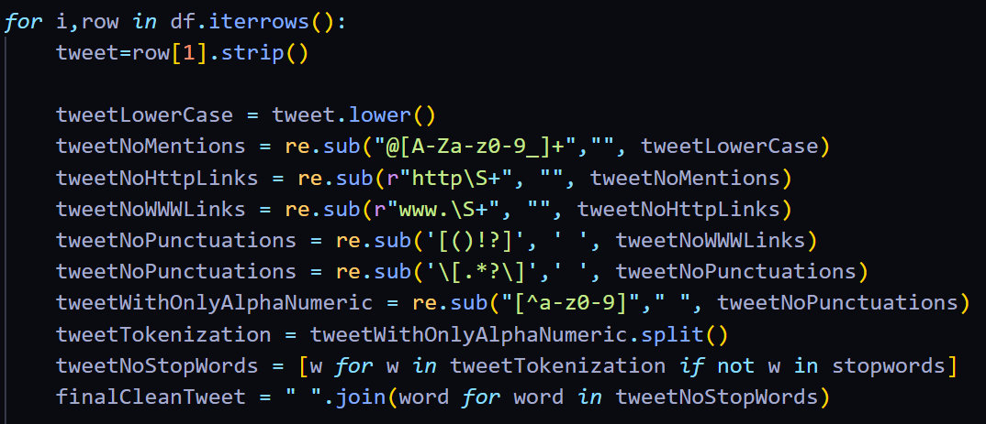
Data Pre-Processing Pipeline:
Extracting TweetText from row
Convert text to lowercase (A->a)
Remove all mentions (@)
Remove all links (No www or http)
Remove punctuations [No (!.,?*)]
Code:
Only alphanumeric Text
Remove Stopwords
Final Cleaned Text Data

Slide 11
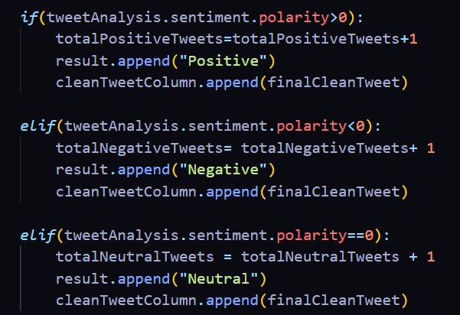
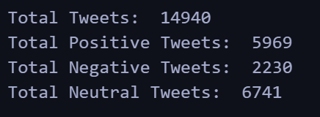
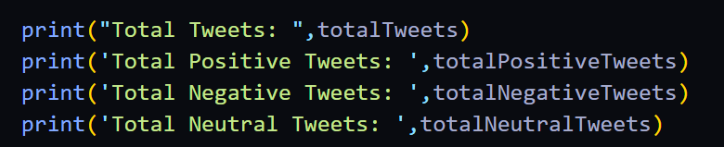
Applying Sentiment analysis:
On Cleaned Tweet Text
By Calculating polarity of our text
If polarity count greater than 0, result = Positive
If polarity count less than 0 , result = Negative
If polarity count is exact 0, result = Neutral
Code:
Output:

Slide 12
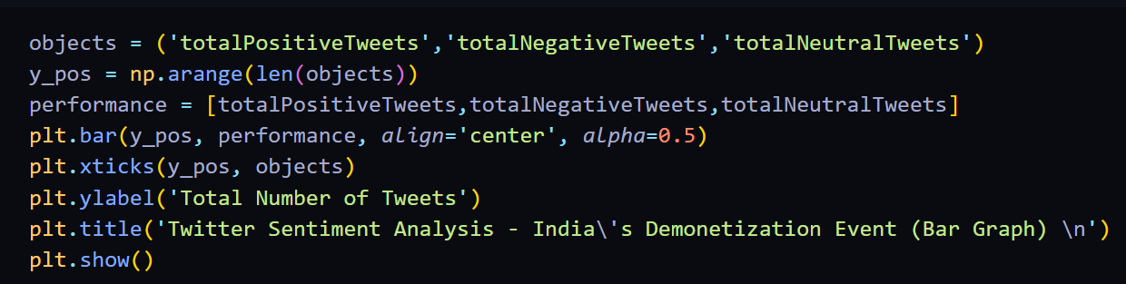
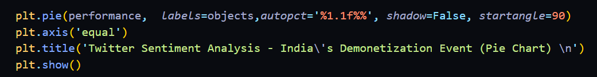
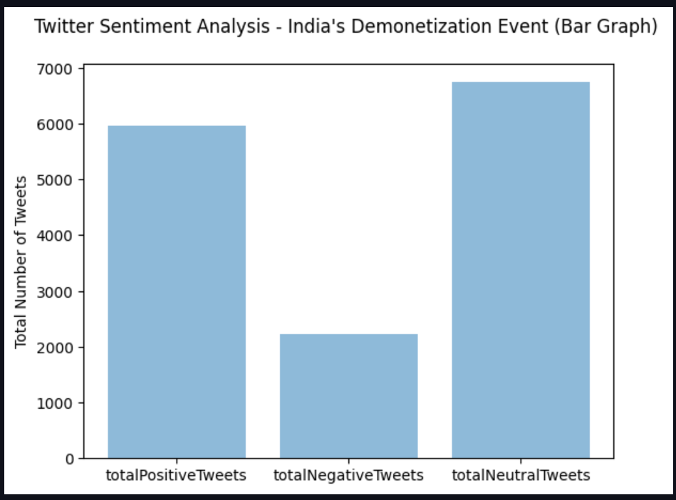
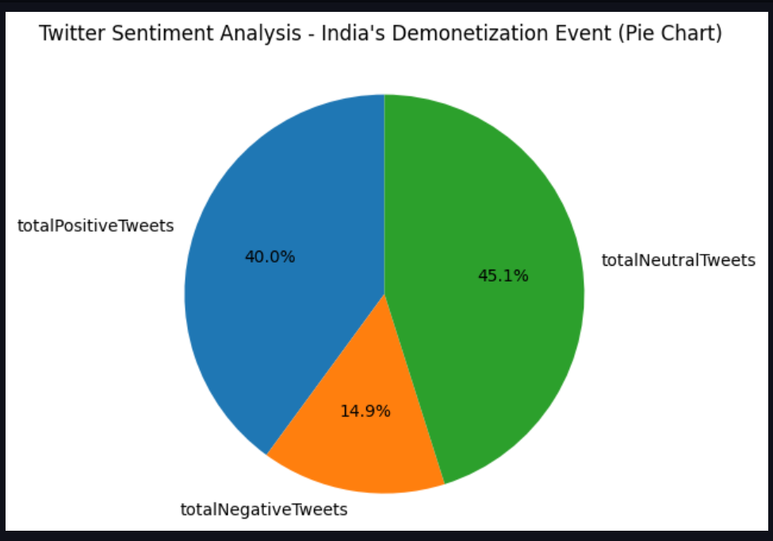
Visualization of result
BAR GRAPH
PIE CHART
Code:
Code:
Output:
Output:

Slide 13
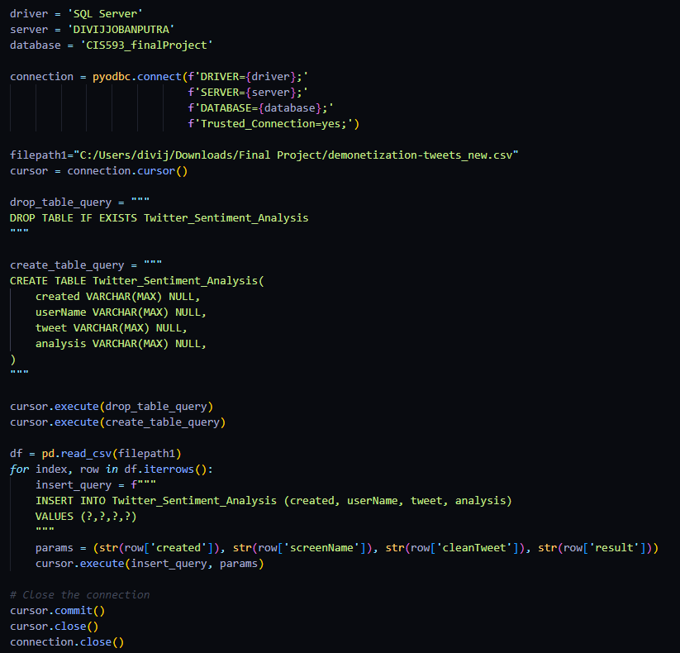
Storing Data and result to RDBMS
Code:

Slide 14
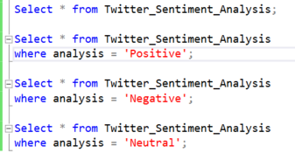
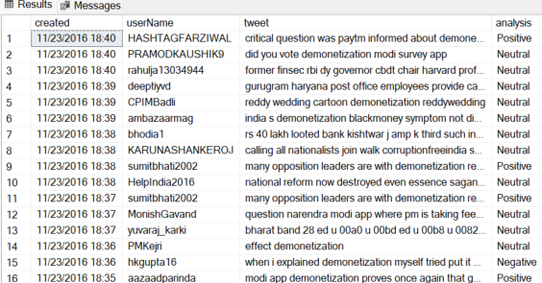
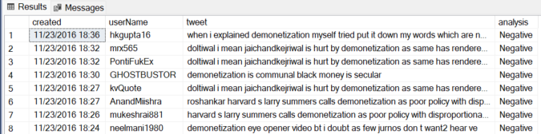
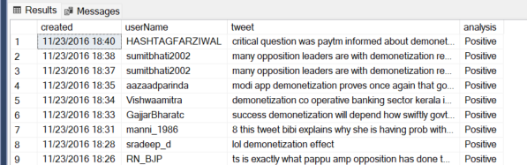
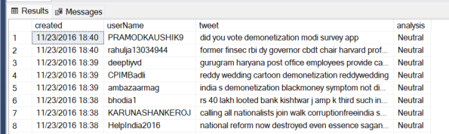
Retrieve data in RDBMS
Retrieving all rows
Retrieving all rows which has Positive Sentiment
Retrieving all rows which has Negative Sentiment
Retrieving all rows which has Neutral Sentiment
All tweets
All Negative tweets
All Positive tweets
All Neutral tweets

Slide 15
Result comparison
5969
2230
6741
Positive Tweets
Negative Tweets
Neutral Tweets

Slide 16
CHALLENGES / PROBLEMS / LIMITATION
Retrieving Data using Twitter API
Twitter essential developer account limitation for searching previous 7 days of tweets.
Kaggle Dataset was not labeled
I could not use Naïve Bayes method to complete my sentiment analysis.
Lexicon-based sentiment analysis
It don’t help in identifying tweets with sarcasm, grammar mistake, misspelling, etc.

Slide 17
THANK YOU

